Slide 1
TxDOT Project 0-5410
Developing Freight Highway Corridor Performance Measure Strategies in Texas

Slide 2
Team:
Center for Transportation Research
R. Harrison, L. Loftus-Otway, J. West, M. Schofield
Texas Transportation Institute
D. Middleton, D. Shrank, T. Lomas
TxDOT
L. Gregorcyk (PC), G. Malatek (PD), D. Stewart (RTI)
FHWA and ATRI

Slide 3
Goals of Scoping Study
Review literature on urban and intercity corridors
Evaluate potential FPMs
Examine ATRI data to evaluate future freight data use
Link Intercity and Urban Corridors
Identify TxDOT Needs

Slide 4
Top Issues in Motor Carrier Industry
14 MC experts surveyed
Several issues could be directly linked to vehicle location technology
82% of motor carriers believe congestion is a serious problem
(ICF, 2003)

Slide 5
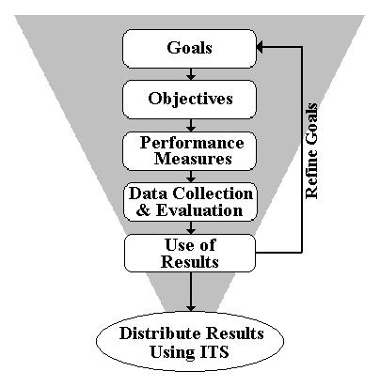
Relating General PM Practices to Freight
Advantages
Communication
Accountability
Operational Improvements

Slide 6
Current FPM Practices (New Jersey)
NJ FPMs fall into 5 categories:
Average Travel Time Measures – Congestion delay
Private Sector Cost Measures – Fuel Costs Per Mile, Insurance Costs
Public Impact Measures – Freight-related Accident Rates, Emissions
Economic Impact Measures – Value of Transportation Goods, Impact of Investments on Regional Economy
Transportation Industry Productivity Measures – Vehicle Miles Traveled, System Performance (by survey), Average Haul Length
NJIT has made the most progress in displaying FPMs, but is still using models, not direct data collection

Slide 7
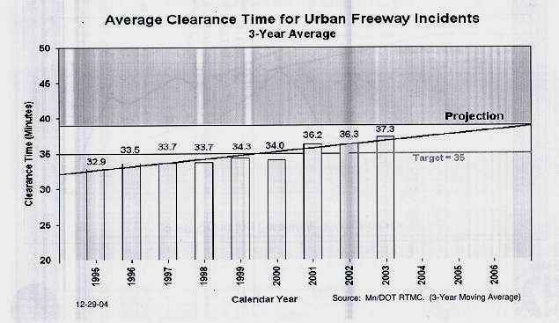
Current FPM Practices (MN/DOT)
Focus on Bottlenecks and Impediments
While MN/DOT has made an ambitious push towards FPM use, little on intercity corridors
“Developmental measures”
“Emerging measures”
“Mature measures”

Slide 8
Five Recommendations for FPM Use
Data must be capable of:
measurement
capturing deficiencies
collection over time
forecasted
being easily understood
Performance measurement has two sides:
Planning and Operational

Slide 9
Data Technologies
Real time technologies for collecting FPM data
GPS locators with more constant updates
Cellular phones
Toll tags
RFID on vehicles registration tags
To take full advantage of the data’s potential, it needs to be collected and processed as close to real-time as possible

Slide 10
FHWA Sponsored FPM Work
Proof of Concept
5 Interstate Highways
(a) Sample 7 DOTs
  (b) Monitor 35 Interstate
  Highways

Slide 11
ATRI Method
ATA sample, using vehicles with GPS on designated routes
Vendor provides aggregate data to ATRI
ATRI puts GPS data on GIS
Output – maps and reports
Planning data

Slide 12
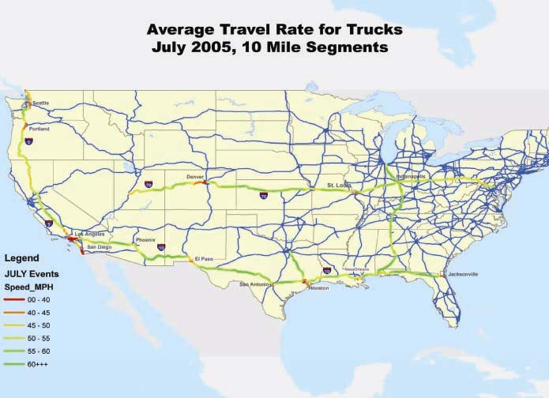
5 Initial Corridors

Slide 13
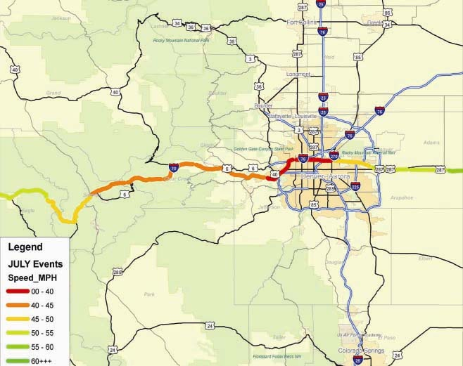
I-70 Denver

Slide 14
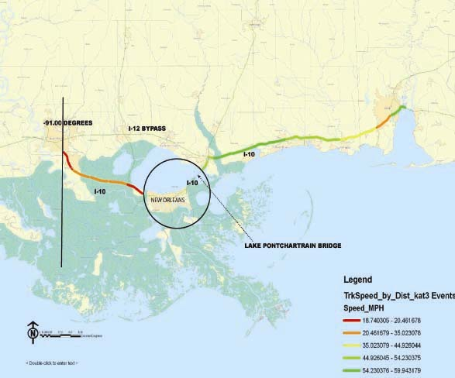
Hurricane Katrina 2005

Slide 15
Collaboration with ATRI
Truck volumes over a 24-hour period
Few areas (and no intercity corridors) use anything other than a percentage of passenger vehicle volume

Slide 16
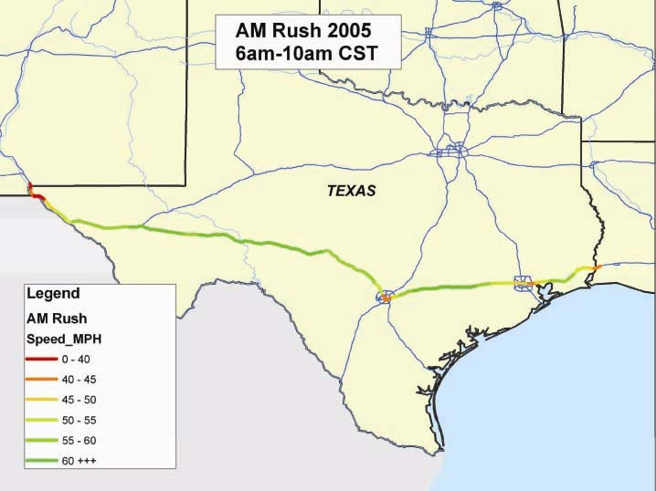
Texas Data for 2005

Slide 17
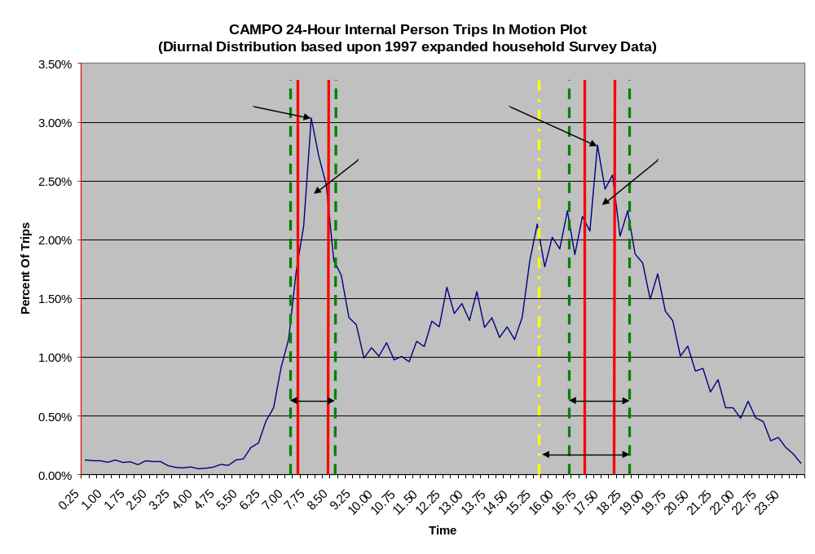
Typical Auto Peaks

Slide 18
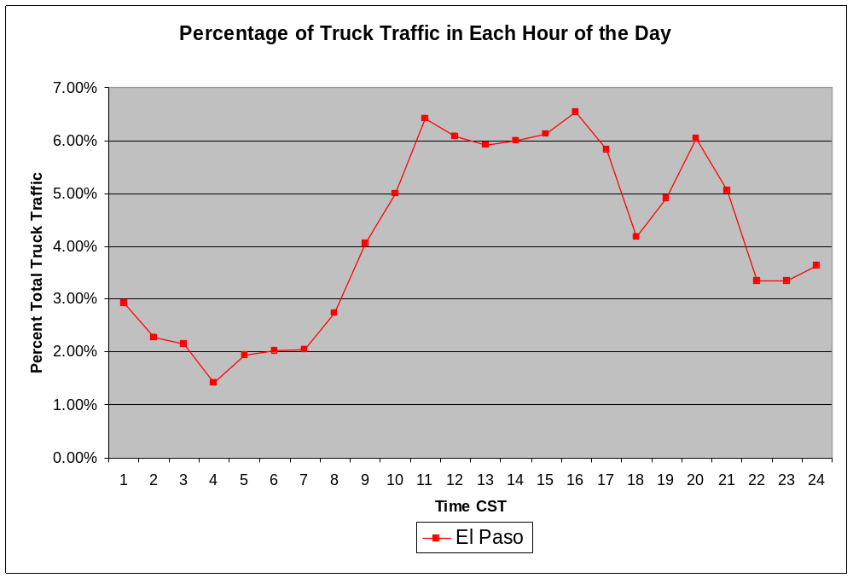
El Paso Truck Traffic
Yet real truck volumes show that trucks make different time choices than cars

Slide 19
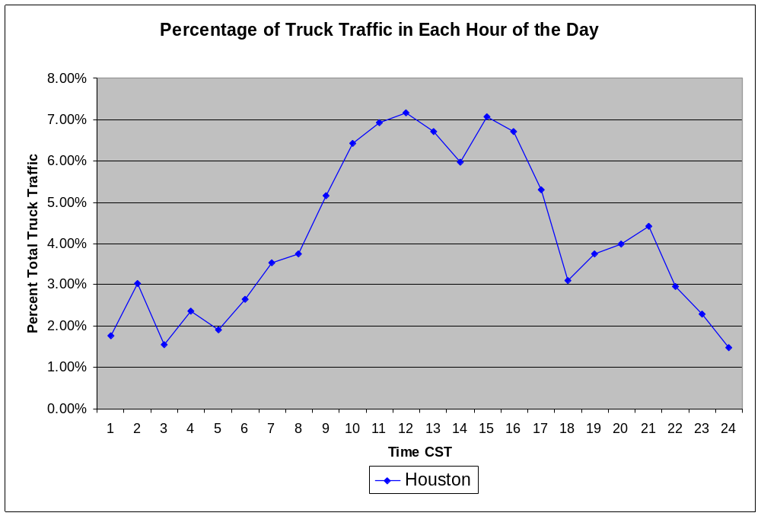
Houston Truck Traffic
Shows truck travel demand in greater detail

Slide 20
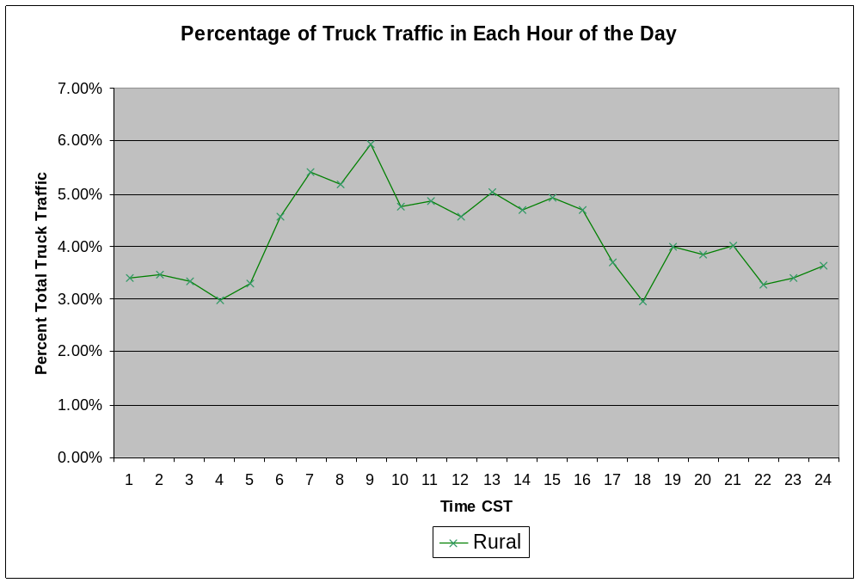
Rural Truck Traffic

Slide 21
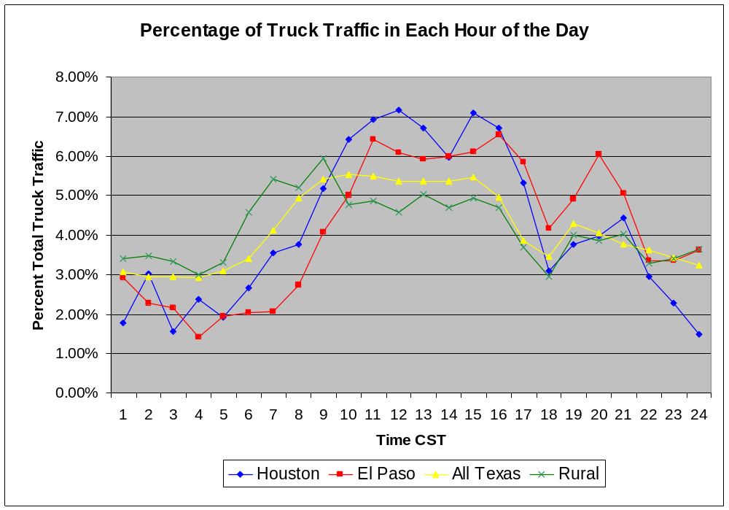
Overall Texas Truck Traffic
FPM with truck origin-destination data could result in the better models of truck movements

Slide 22
Linking Intercity and Urban Corridors
Urban Congestion Programs
  Mobility Monitoring Program
    Began 2001
    Uses archived detector data
    30 urban areas
  Urban Mobility Report
    Began 1982
    Uses HPMS data
    85 large urban areas
  Urban Congestion Reporting Program
    Began 2002
    10 urban areas

Slide 23
Mobility Monitoring Program
Speed and count accuracy varies
Lack of calibration and maintenance
Use of spot speeds to estimate travel time
  Lane-by-lane data combined into “stations”
  Estimate link properties – “zone of influence”
  Group freeway links with similar adjacent links

Slide 24
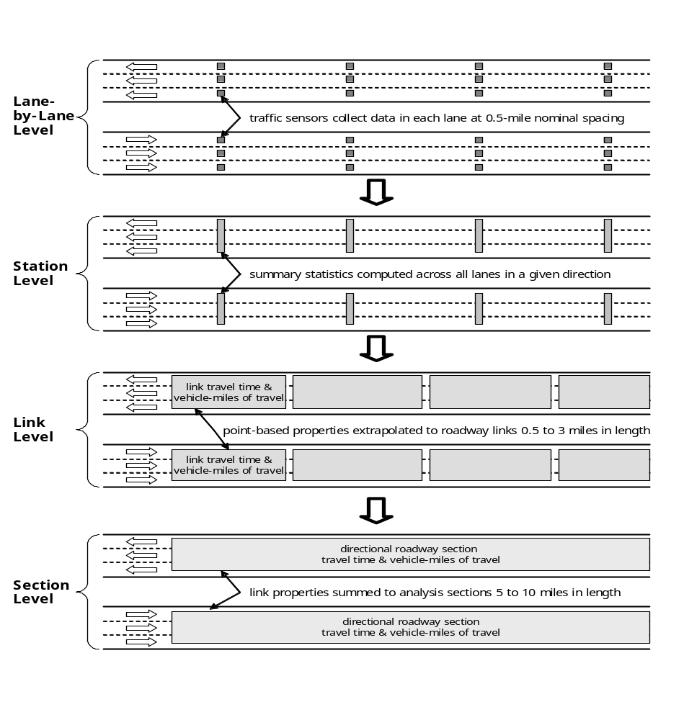

Slide 25
Possible Linkages: ATRI & MMP
Different vehicles monitored
Sampling rates
TTI and BI common
Need verification

Slide 26
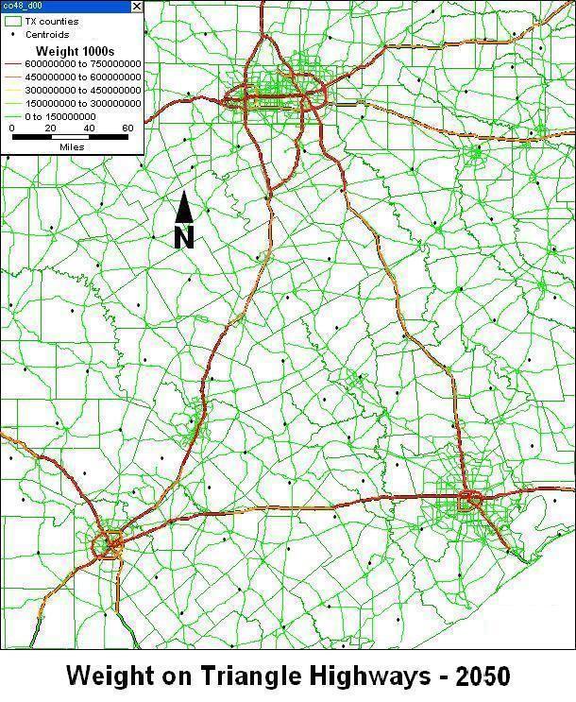
Pavement Management Uses

Slide 27
Future: Planning vs. Operational Improvements
To date, nearly all FPM (even general PM) use has focused on long-term planning
With more frequent, real-time data collection, trucks could become probe vehicles representing total traffic
Currently, urban traffic data provide information to metro users,
  Extended to intercity travelers, FPM will provide trip estimates

Slide 28
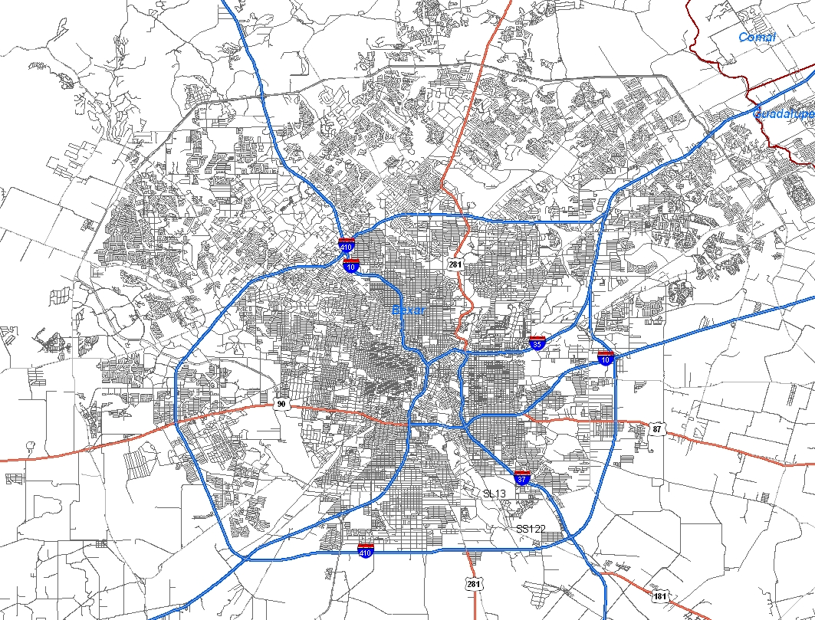
Inland Port/Big Box Uses
Big-box and inland port locations may be driven by data on truck locations and volumes

Slide 29
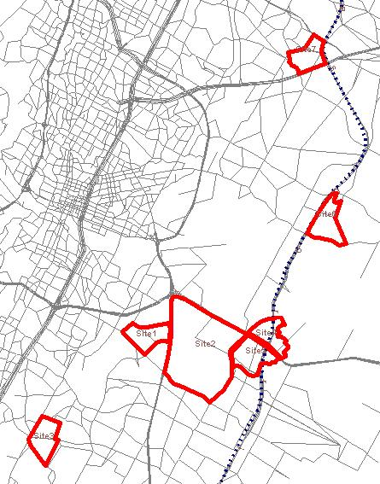
Inland Port/Big Box Uses
As inland ports and big boxes locate along the TTC and other corridors, more precise truck travel patterns will prove invaluable in locating and managing distribution centers
Possible Inland Port Locations

Slide 30
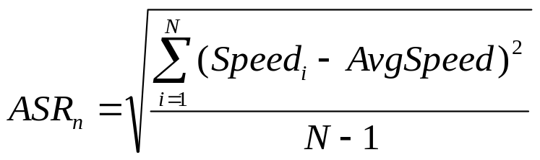
Other Future Uses
Reliability measures, either TTI’s Buffer Index or a standard deviation, mapped on small highway segments over entire regions to pinpoint bottlenecks
Real-time data processing allows (a) accidents to be accurately located when reported and (b) emergency routing
Border/port wait time management
Other ITS uses such as real-time overhead signing for traffic optimization.

Slide 31
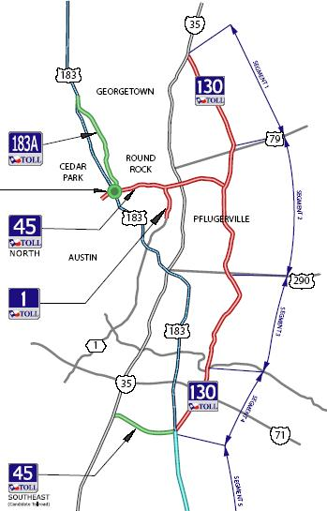
Traffic Demand Management
As tolled highways are built in Texas, higher utility
Truck location data can provide real-time travel times on different routes
Using time values, travel times could calculate underpin road pricing

Slide 32
Questions?

